Slide 1
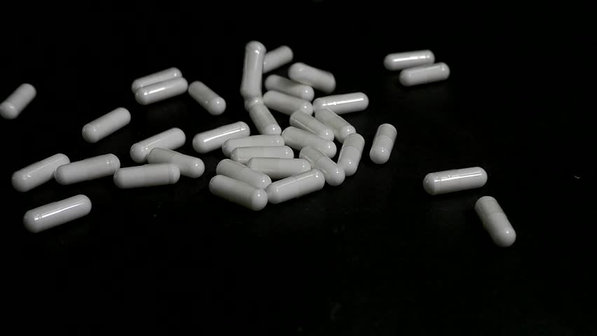
Analysis of Medicaid Prescription Data in the United States
Joaquin Cuomo, Andre Hochmuth, Mitchell Rouault, Josh Munoz

Slide 2
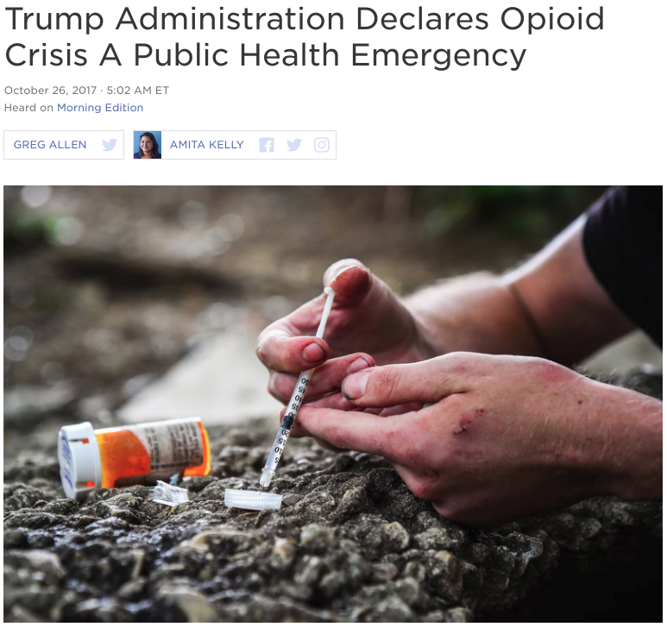
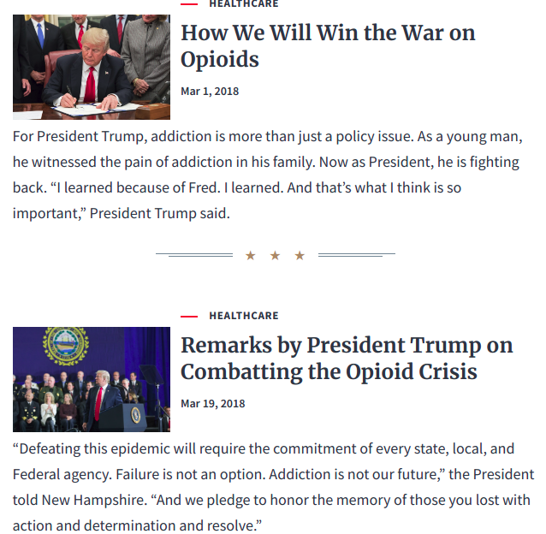
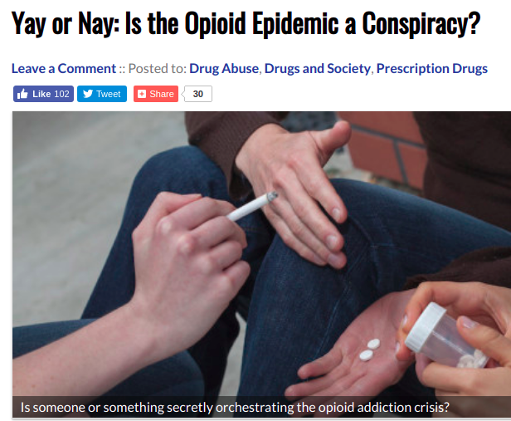
https://www.npr.org/2017/10/26/560083795/president-trump-may-declare-opioid-epidemic-national-emergency
https://drugabuse.com/yay-or-nay-is-the-opioid-epidemic-a-conspiracy/
https://www.whitehouse.gov/opioids/
Notes:
Since 1990 there has been an increase in the consumption of both legal and illegal opioids. This type of drug is prescribed for pain relief and because one of the effects is releasing dopamine it’s highly addictive.
Last year President Trump declare the opioid crisis as a National Health Emergency. On the other hand, other parties argue that there is not such epidemic.

Slide 3
Hypothesis
First
Non-opioids are being replaced by opioids as painkillers
Second
The epidemic is not limited to opioids
Notes:
That’s why we proposed the following hypothesis. Firstly, we will try to probe that opioid prescriptions are increasing because they are replacing other type of painkillers. And then, after accepting or rejecting this hypothesis we proposed a second hypothesis in which we try to probe that there is a general drug epidemic and it is not just bounded to opioids.

Slide 4
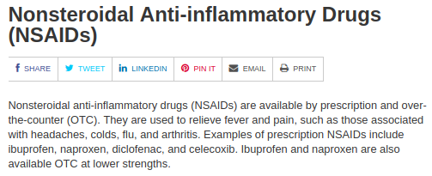
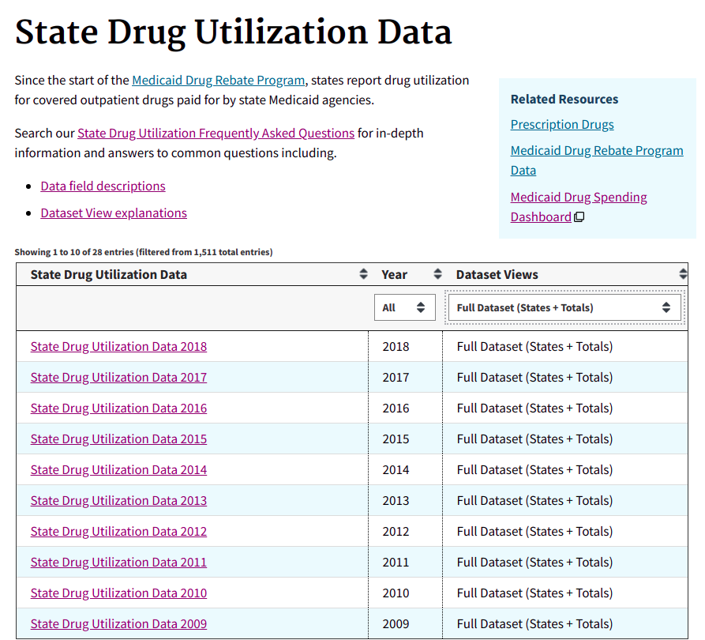
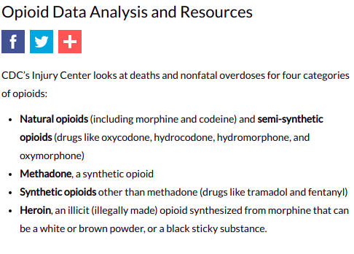
Datasets
https://www.fda.gov/Drugs/DrugSafety/PostmarketDrugSafetyInformationforPatientsandProviders/ucm103420.htm
https://www.cdc.gov/drugoverdose/data/analysis.html
https://www.medicaid.gov/medicaid/prescription-drugs/state-drug-utilization-data/index.html
Notes:
To work on our hypotheses we use the state drug utilization since 1992 from the health insurance Medicaid which contains the amounts of all drugs reimbursed. But, to be able to compare opioids and nonopioids we had to use two more databases listing all opioids and all non-opioids. For picking those out we researched for the best approach and we conclude on using CDC dataset for the opioids and the FDA for the non-opioids.

Slide 5
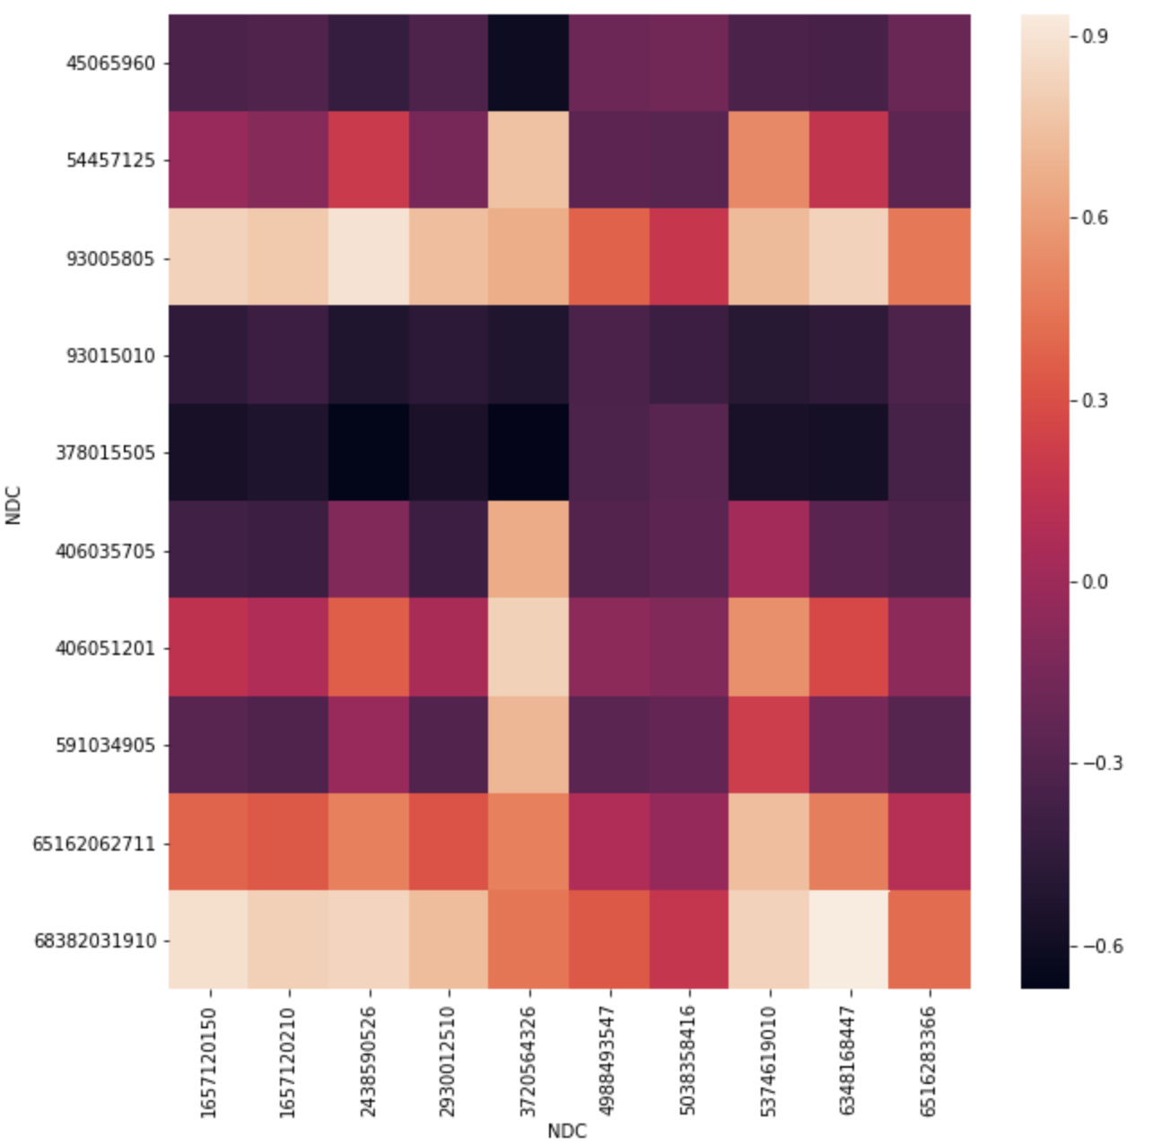
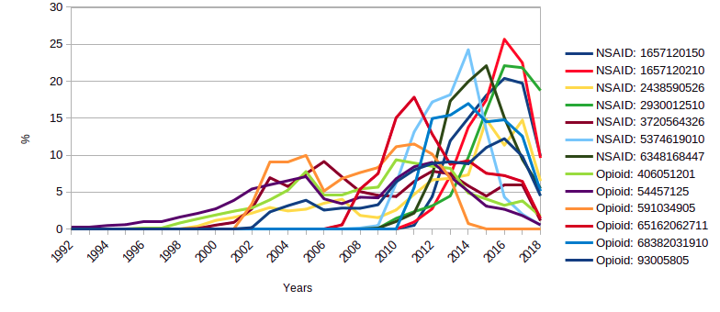
Correlation Analysis
Correlation opioid vs non-opioid top K nationwide
Opioids vs Non-Opioids: Mostly Positive Correlation
Opioids vs Opioids Nationwide: Mostly Positive Correlation
Comparing States: No Correlation between Separate States

Slide 6
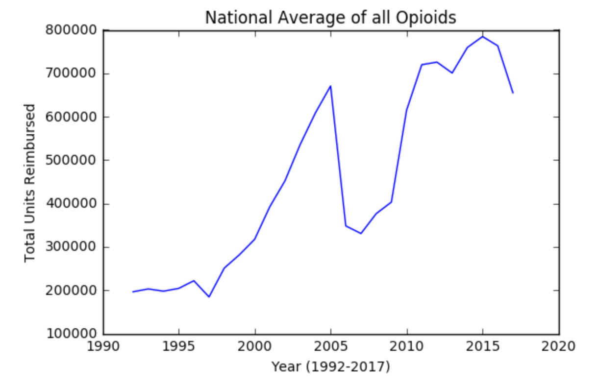
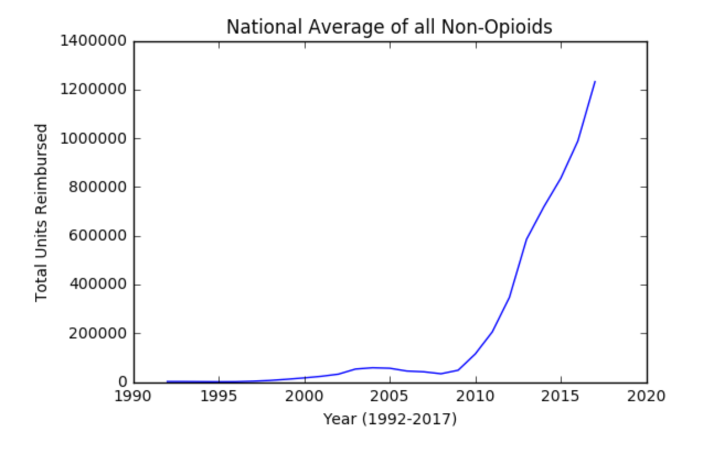
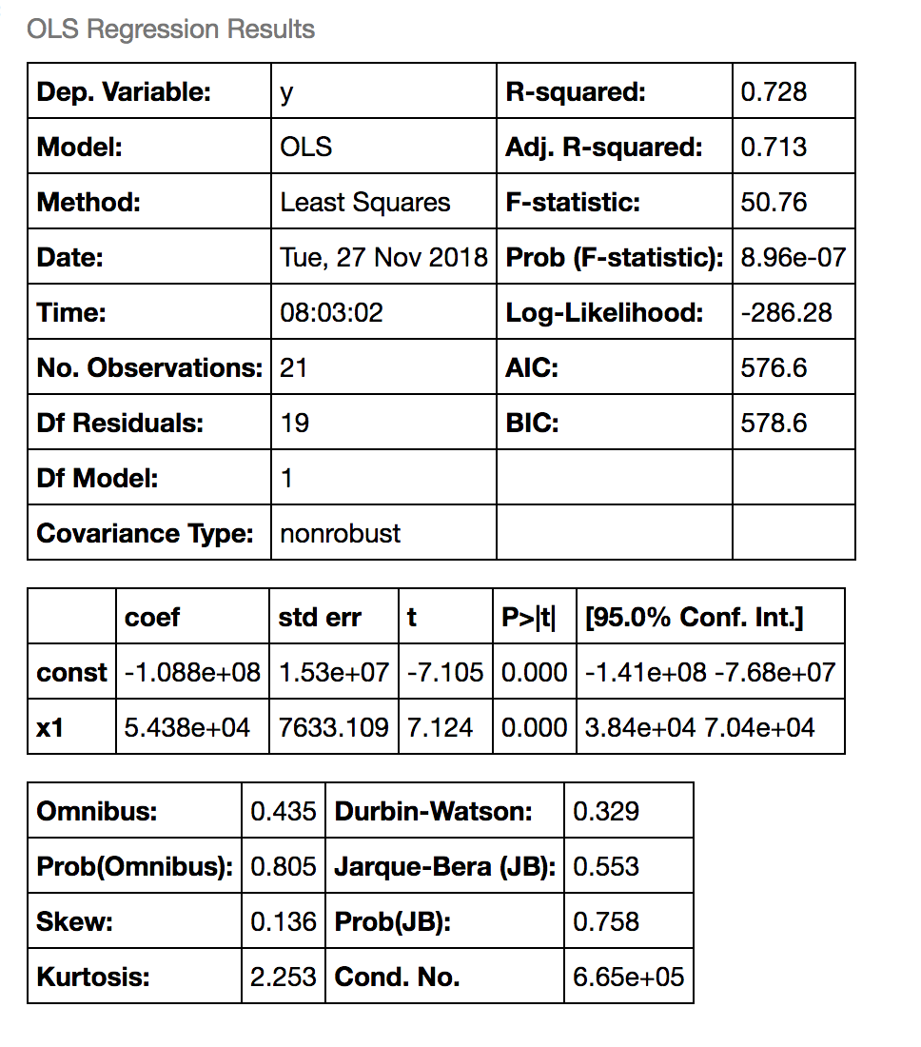
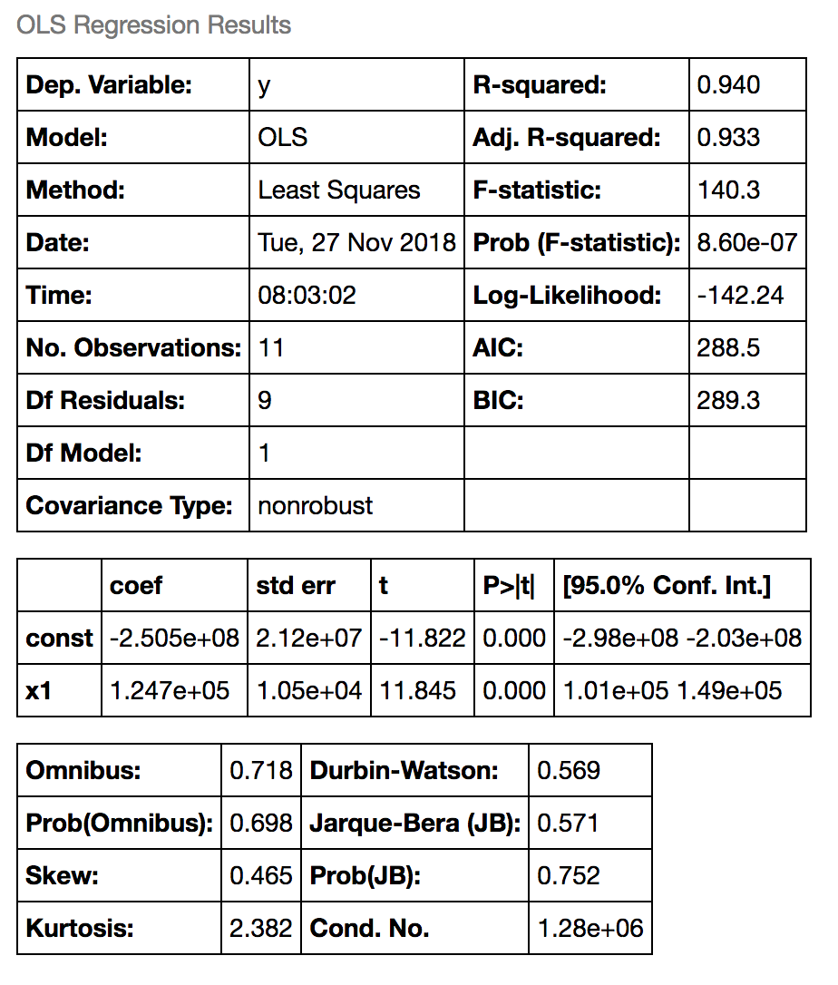
Trend Analysis

Slide 7
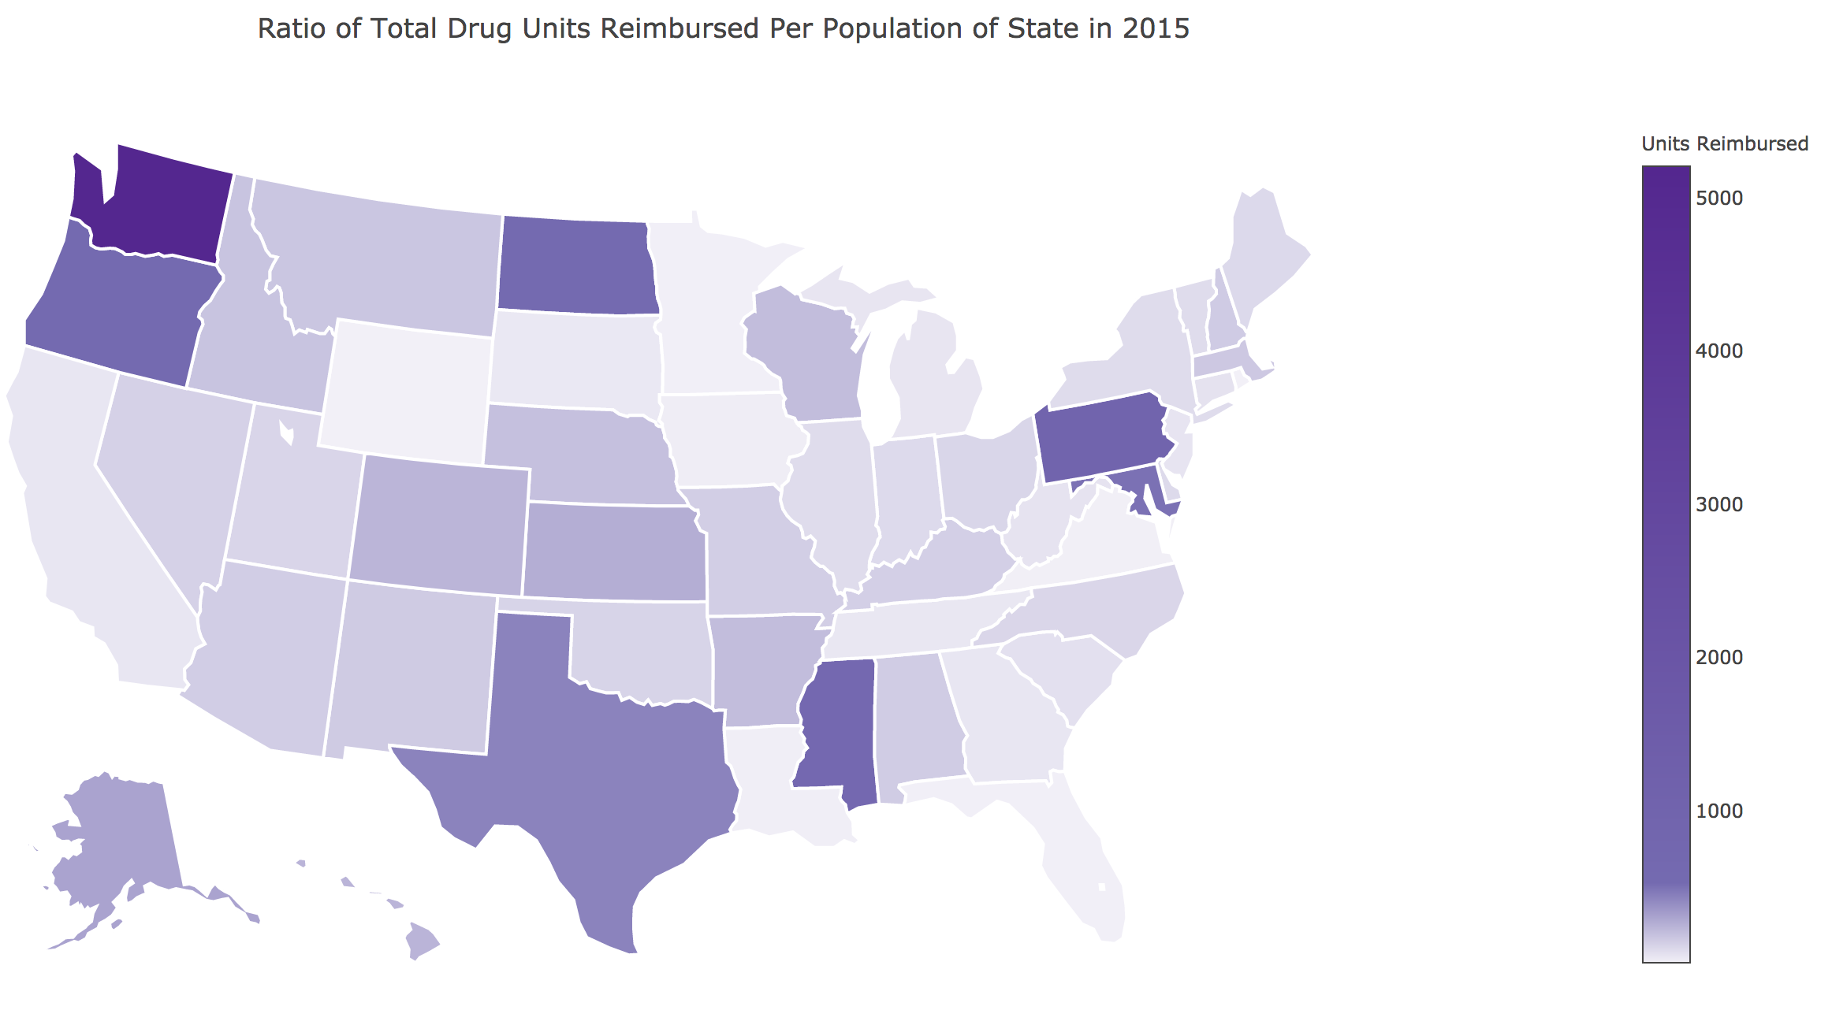
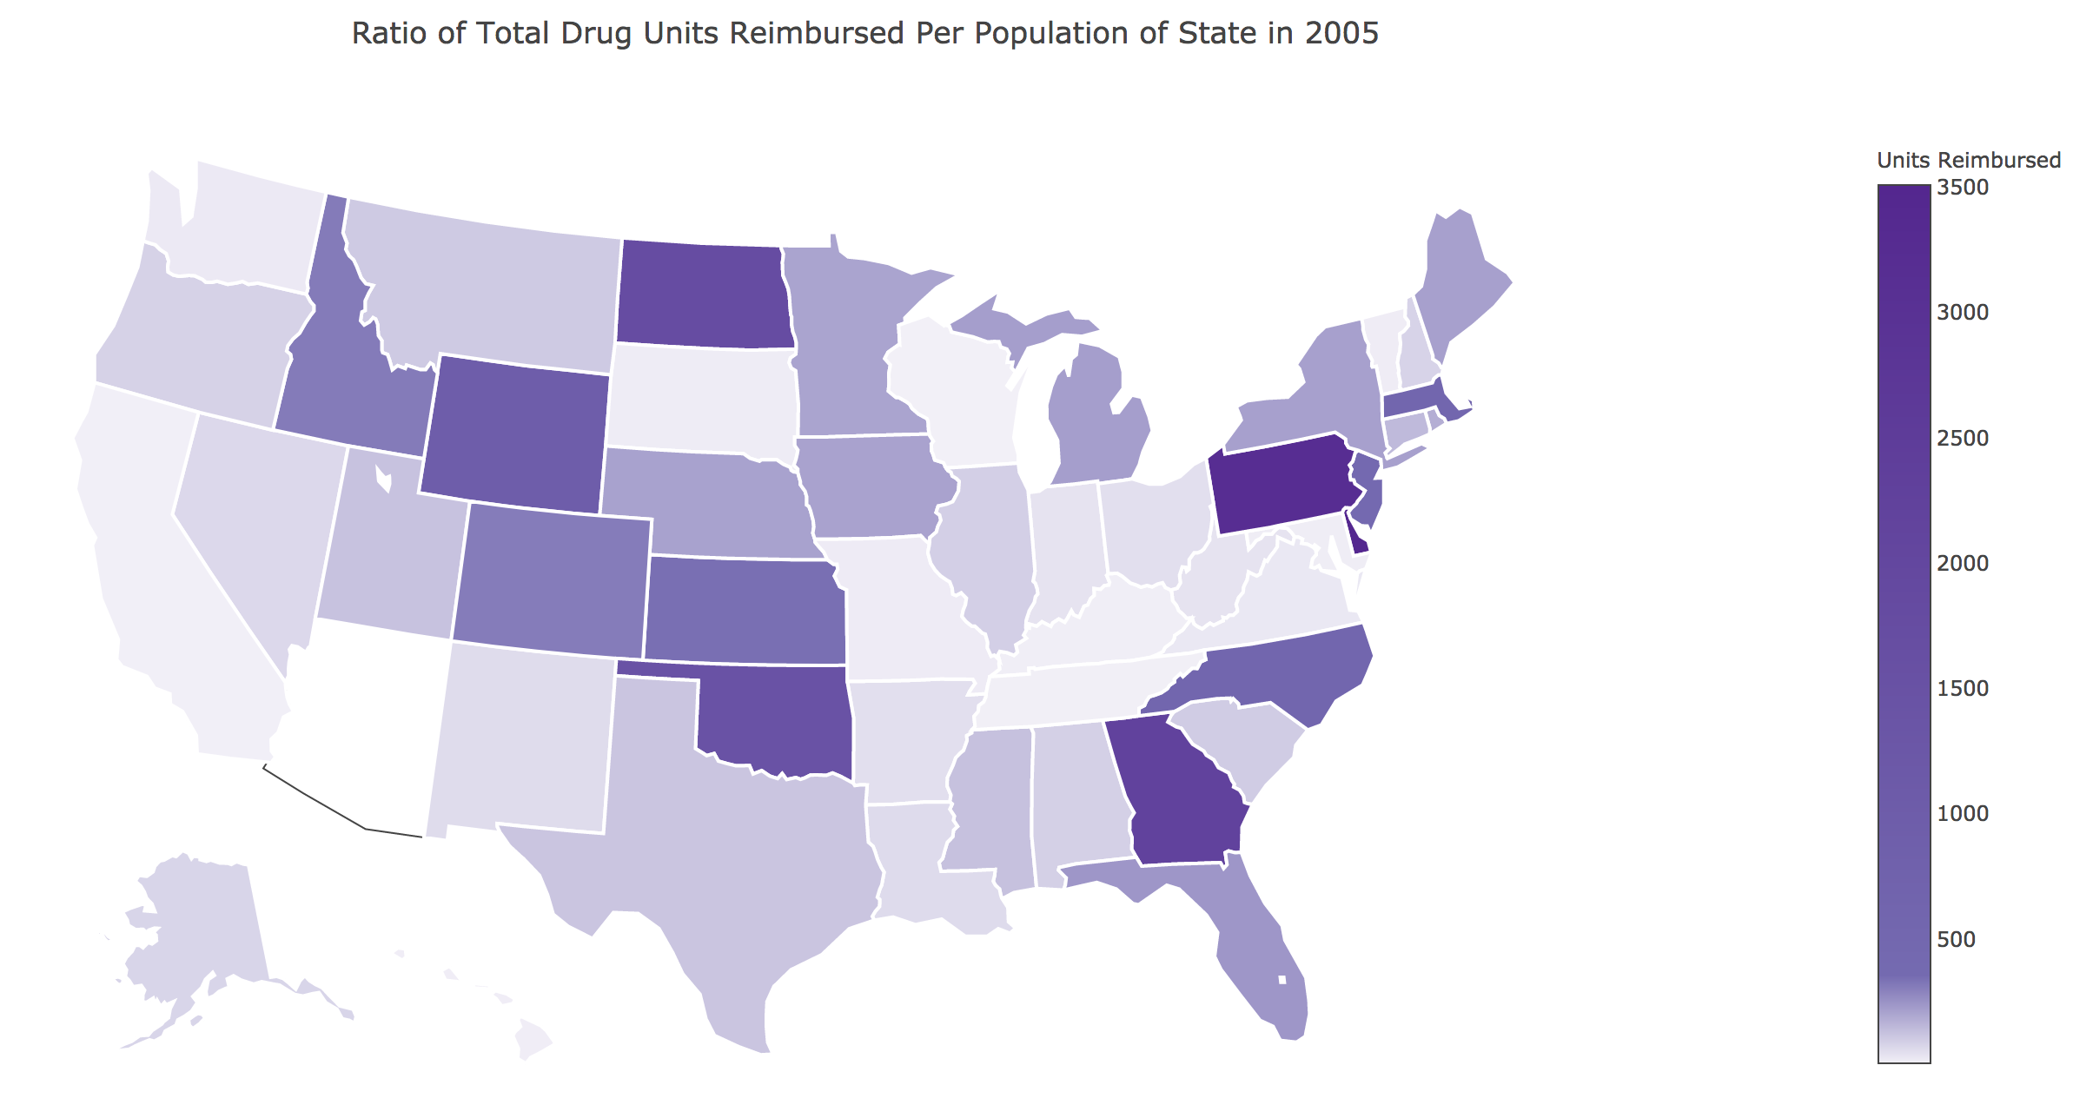
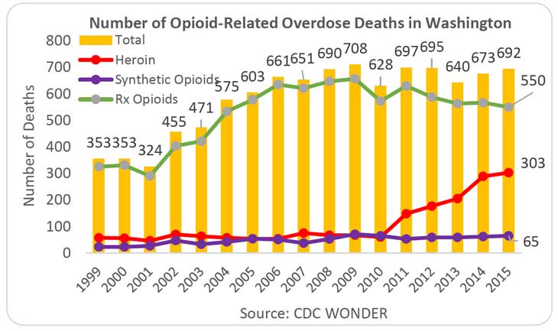
State Trends
https://www.drugabuse.gov/drugs-abuse/opioids/opioid-summaries-by-state/washington-opioid-summary

Slide 8
Conclusion
We have found that our hypothesis that opioids are increasing in a dramatic fashion because they are being used as a replacement for other painkillers has been rejected.
The data has shown that non-opioid units have seen an increase in the same time period. This indicates that both types of drugs have been heavily rising since 2010.
We have not fully checked the validity of our second hypothesis that there is a prescribed drug epidemic and we suggest further research.

Slide 9
Questions?

